Slide 1
SPECIFICATION ADVANTAGES
Products, Services, Capabilities

Slide 2
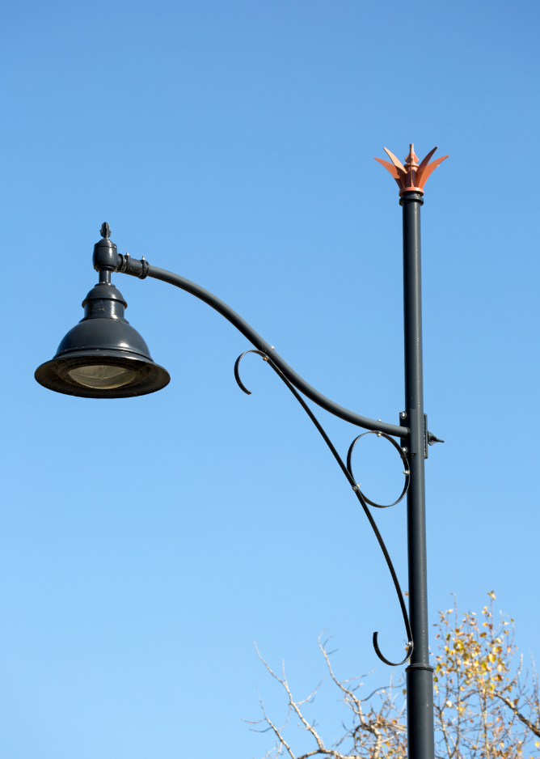
Valmont Decorative Core Capabilities
Styles from Historic to Transitional to Contemporary
Trend setting global inspired designs
Area and street lighting options for any budget
Large scale projects
Notes:
Euro is more advanced

Slide 3

Decorative Advantages
Maximum impact is built from the harmony of all components.
Notes:
Pair fixture with pole together for max impact

Slide 4
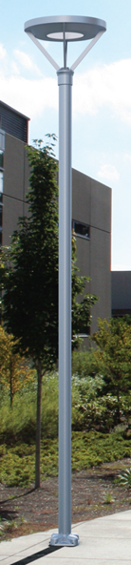
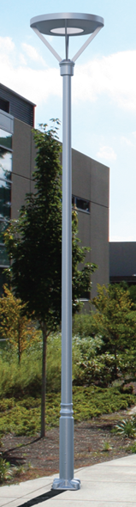
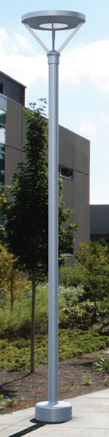
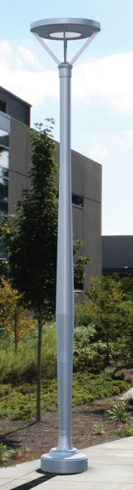
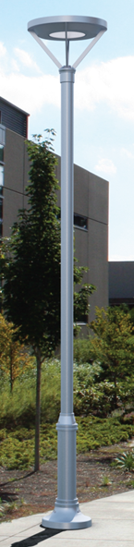
Same Fixture with Different Pole
Baseline
+ $50
+ $25
+ $ 280
+ $256
Notes:
One fixture with variety of poles
Lock in spec with options

Slide 5
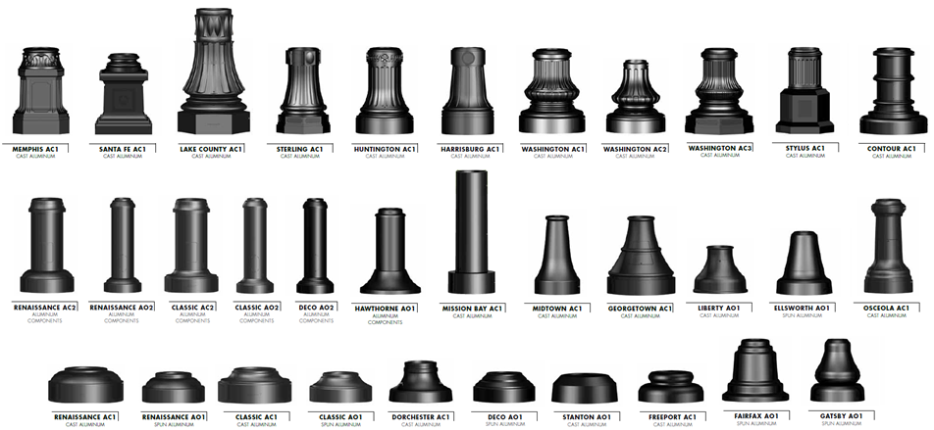
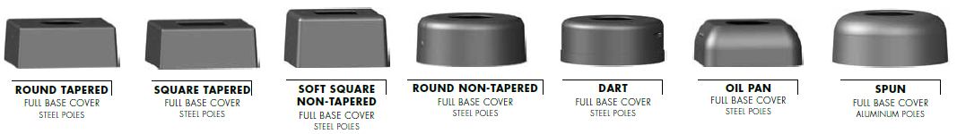
Decorative Bases
Notes:
Start at bot and work up
Standard cast alum pieces
1-2 pieces
Come in family – range from sm to lrg street lighting to improve uniformity

Slide 6
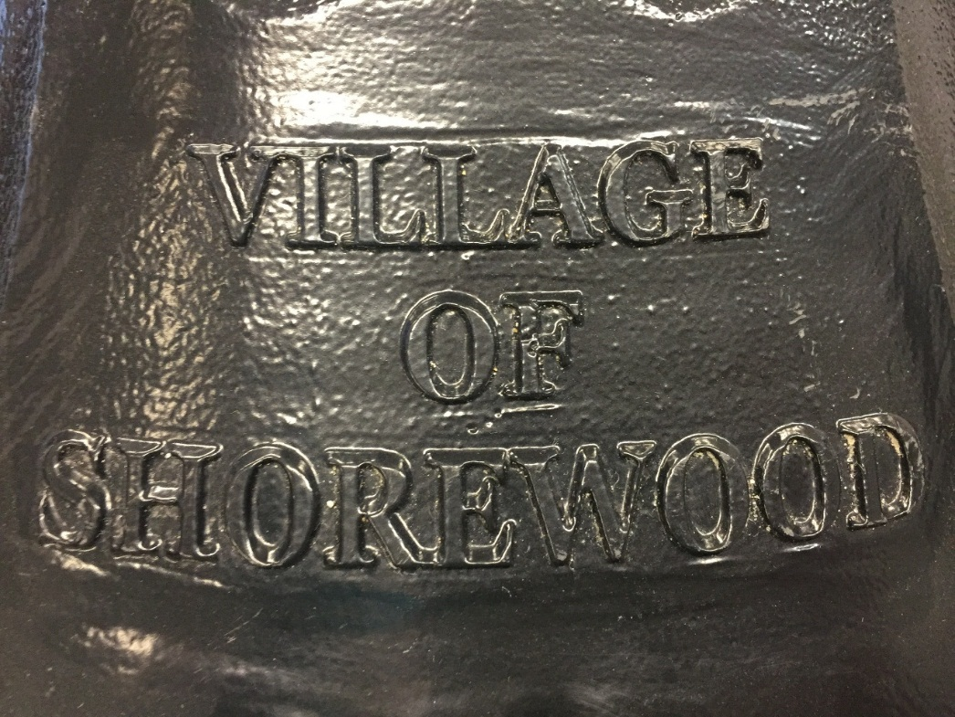
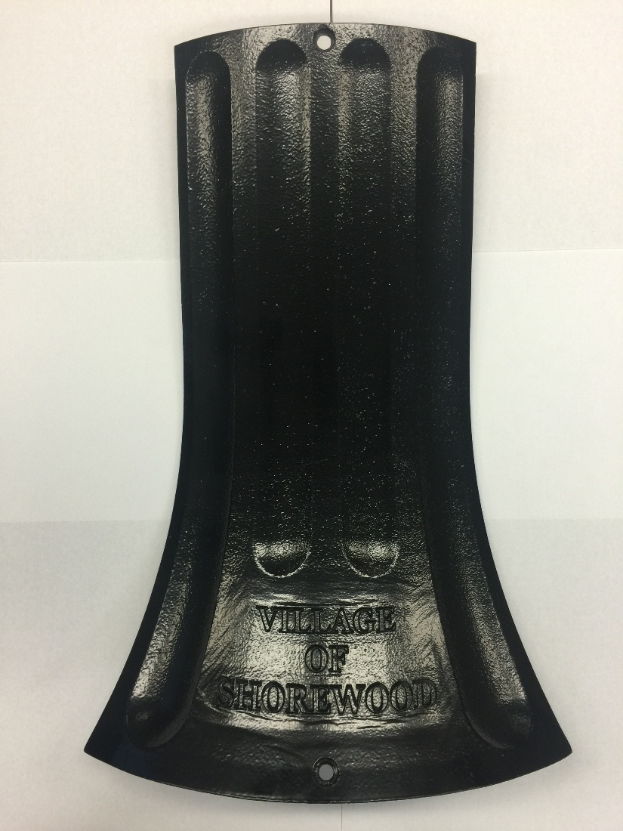
Customizable Base Cover Door
Huntington HN24AC only
Tapered: 6.00”-10.13”
Non-Tapered: 5.63”-9.75”
Notes:
Wide range. Small scale to large – spec lock
Can be customized with city logo / info

Slide 7
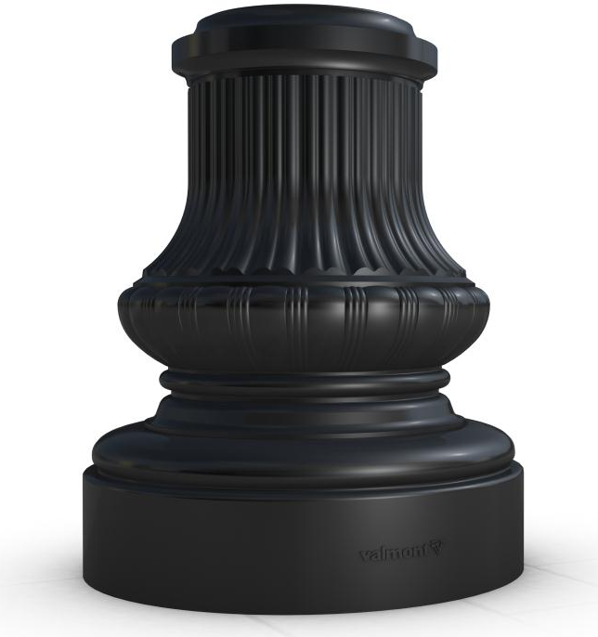

Enduro Base Covers
Elastomeric Urethane
  Optimum impact resistance
  Non corrosive
  Non conductive
  No scrap value
  Colored black throughout
    May be tinted different shades

Slide 8
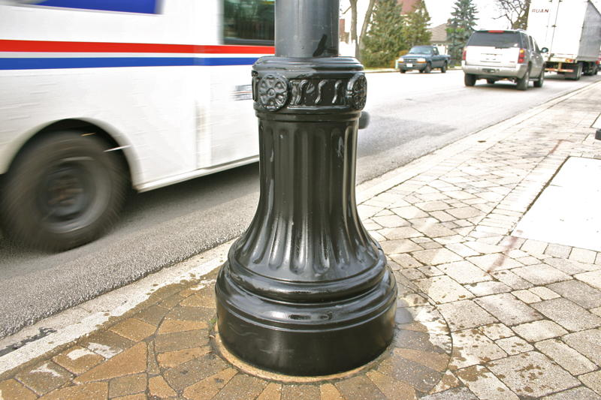
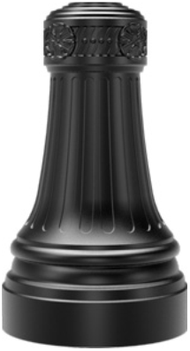
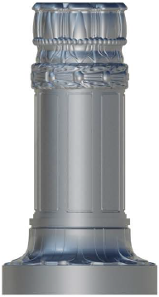
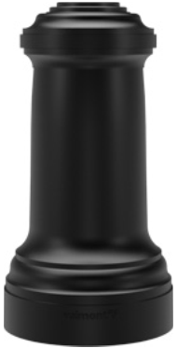
Enduro Base Covers
Great for:
  Gravel spray
  Direct contact with salt
  Pedestrian abuse
  Landscape equipment
  Lack of maintenance
  Coastal or regions close to water

Slide 9
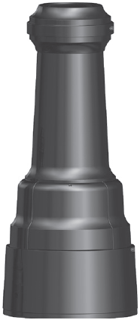
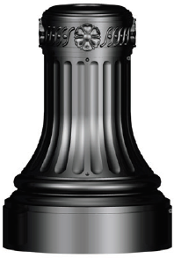

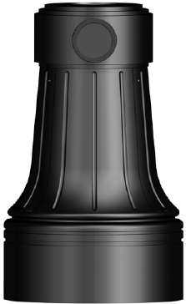

FHWA Approved Breakaway Systems
Valmont is the only light pole manufacturer offering both steel and aluminum light poles in FHWA approved breakaway systems
There are five decorative bases approved:
Notes:
We did personal testing before major requirements

Slide 10
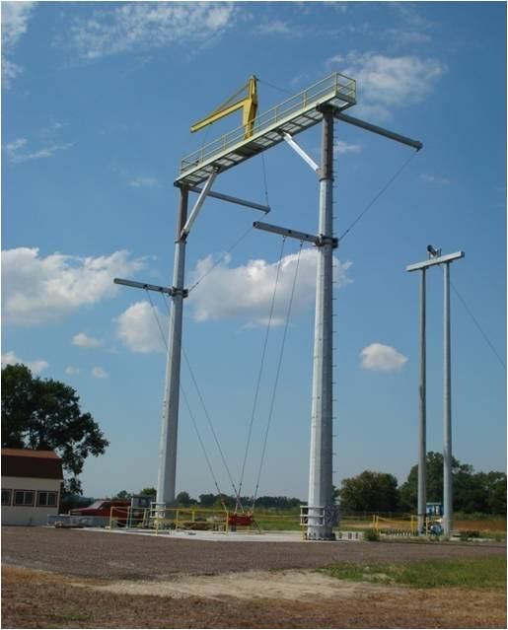
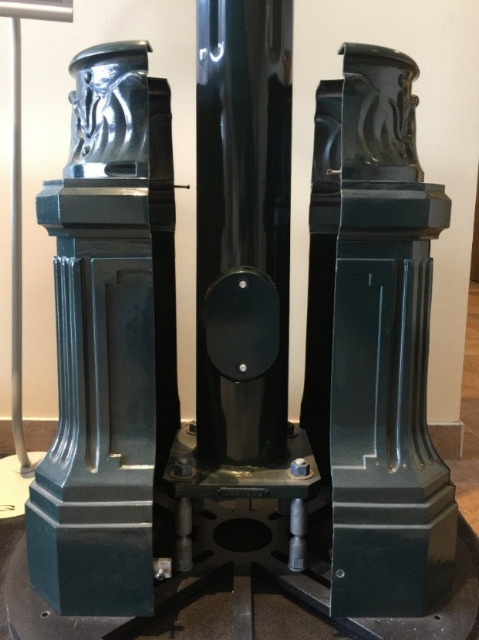
FHWA Approved Breakaway Systems
FHWA/AASHTO Approved Breakaway Facility
Full Scale Testing Capabilities
Breakaway Couplings
Notes:
Have to purchase with breakaway couplings
Bases are sized and adjusted for this application

Slide 11
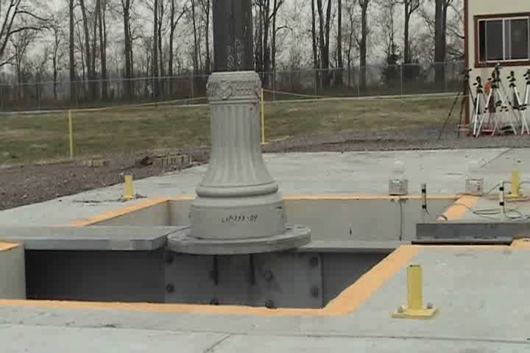
FHWA Approved Breakaway Systems

Slide 12
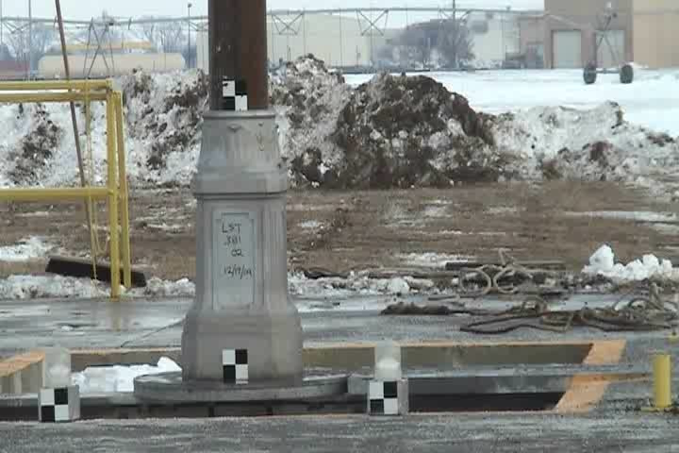
FHWA Approved Breakaway Systems

Slide 13
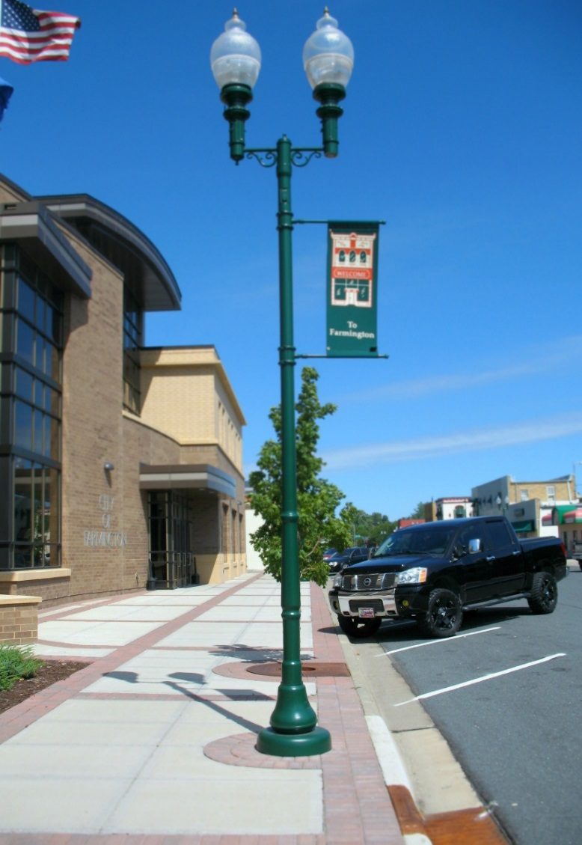
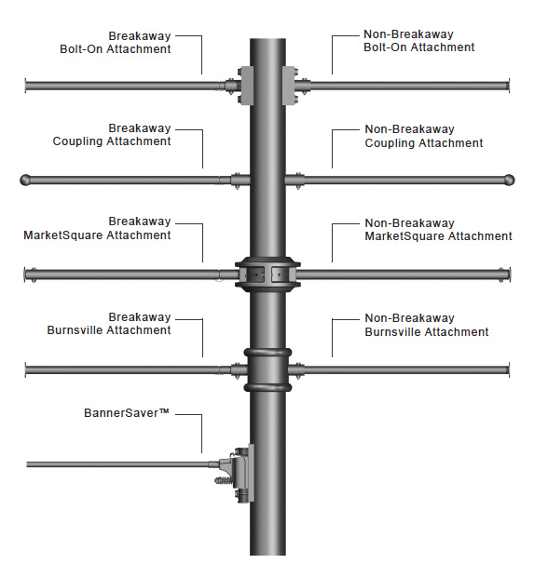
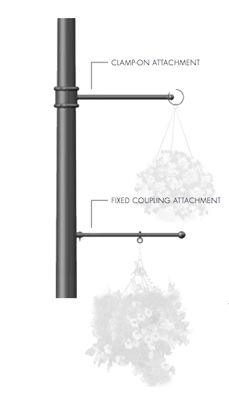

Banner Arms, Flag Holders, and Plant Hangers
Notes:
Breakaway and non break
Add visual interest with banner arm
Tell Valmont ahead of time before you add a banner arm / plant hangers / flags

Slide 14
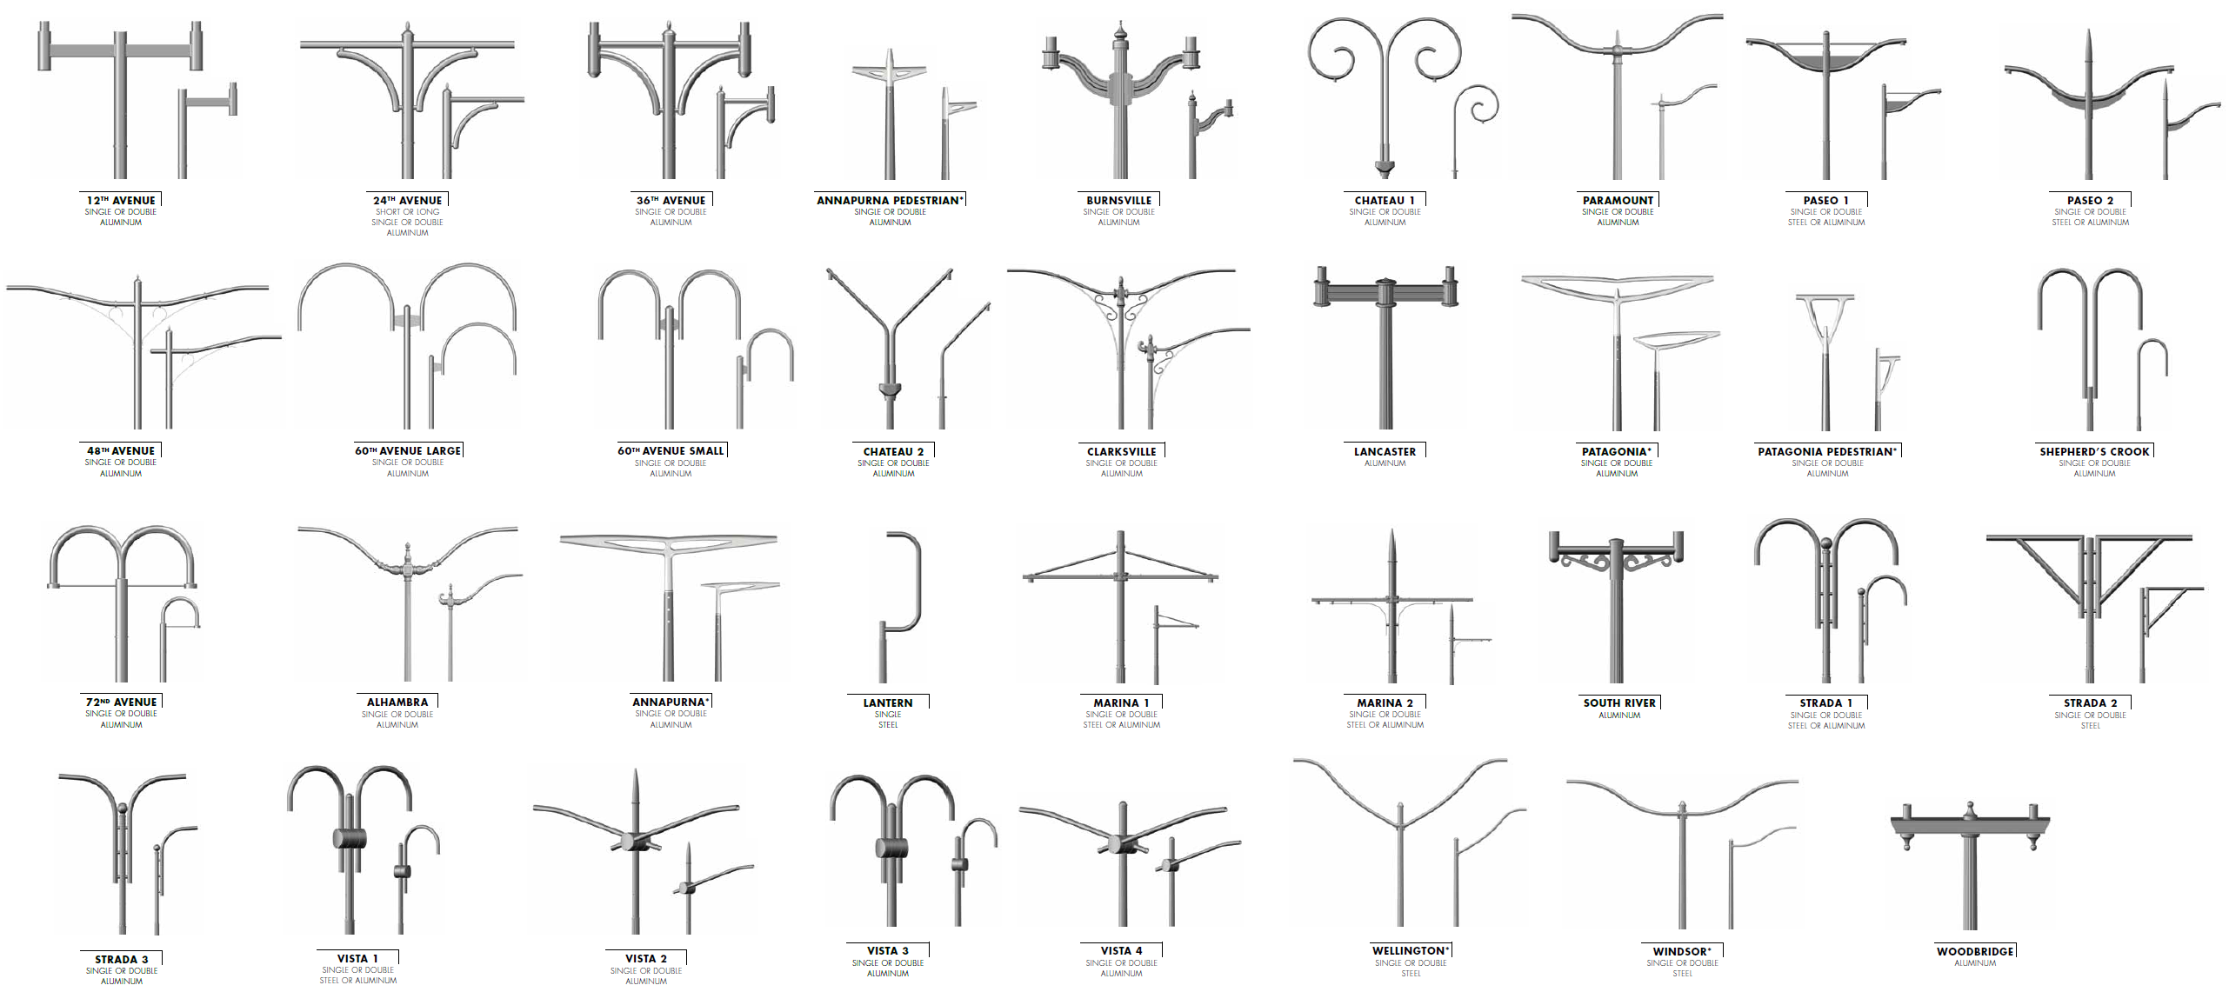
Decorative Arms – Steel and Aluminum
Notes:
Ped and street scale in a lot of these

Slide 15
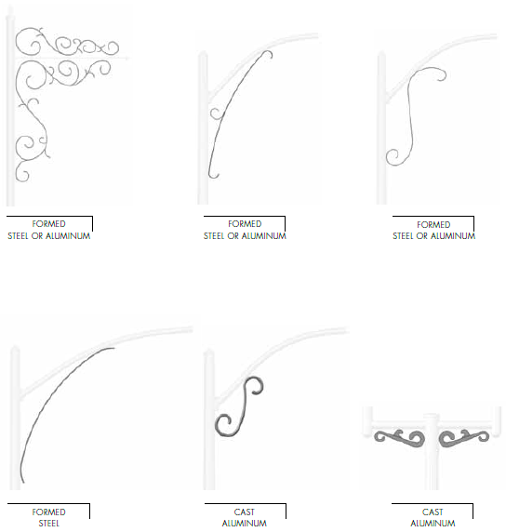
Scrolls – Formed and Cast
Notes:
Affordable options
Endless options but most common is bottom left

Slide 16
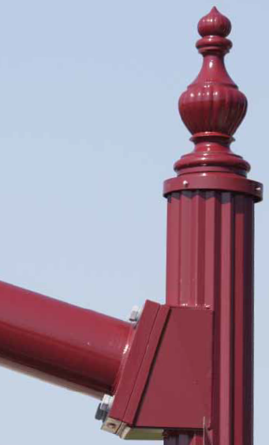
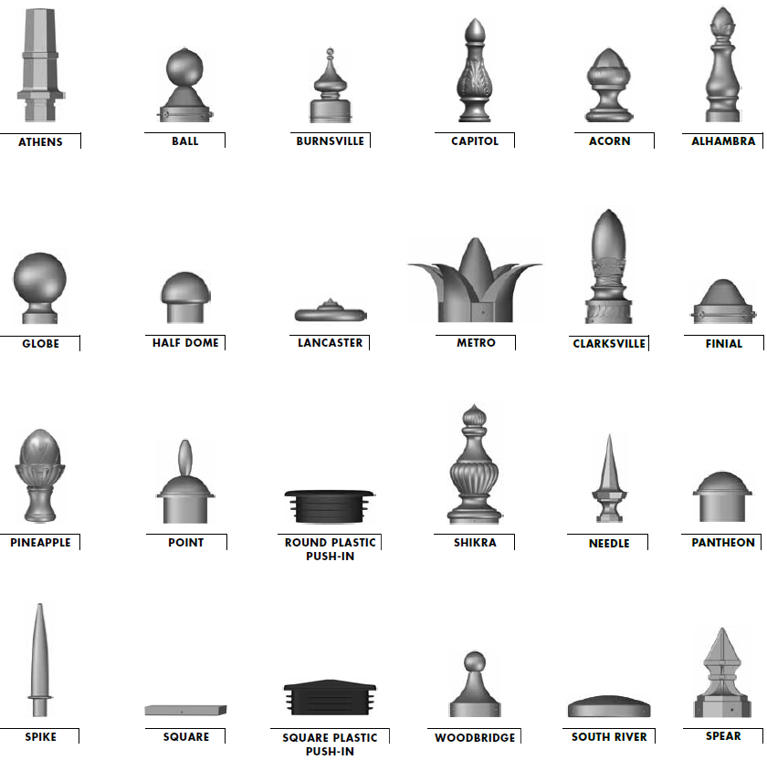
Finials and Pole Caps
Notes:
Standard options – dress up the top of the pole.
Most will come with stnd pole cap

Slide 17
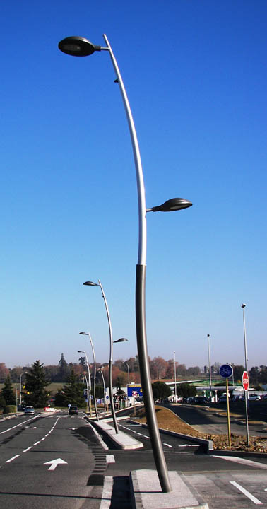
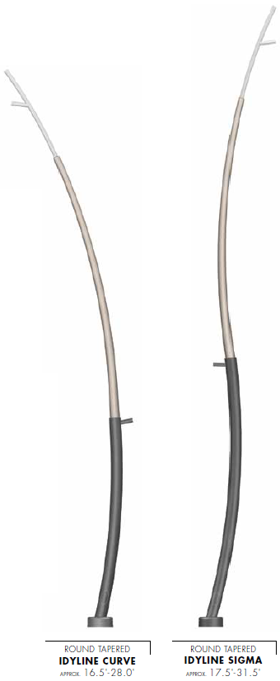
Idyline – Round Tapered Curved Aluminum
Notes:
Standard offering
Affordable
Street and ped
2 tones or single
If you have higher mounting heights, you can try our new curved steel poles

Slide 18
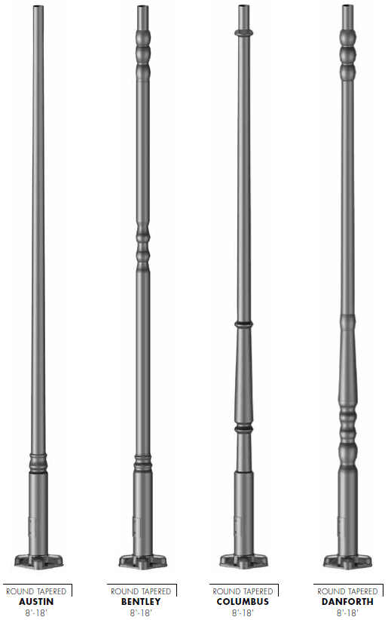
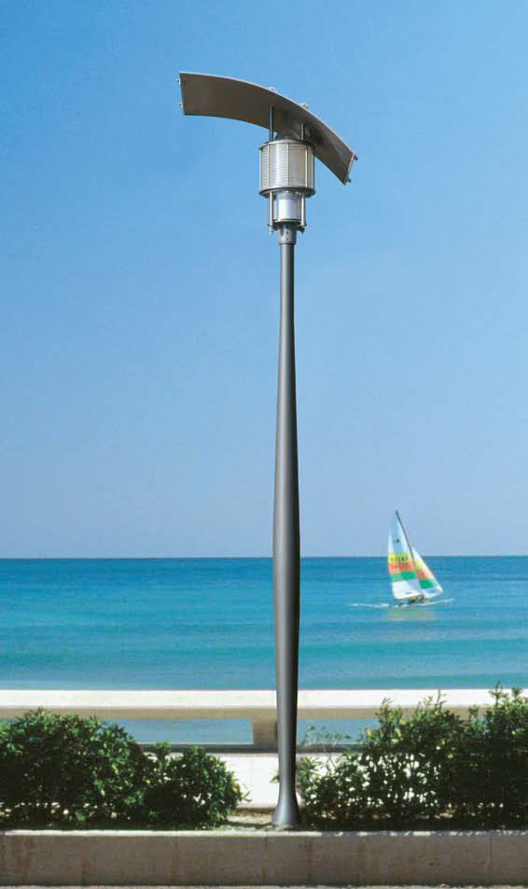
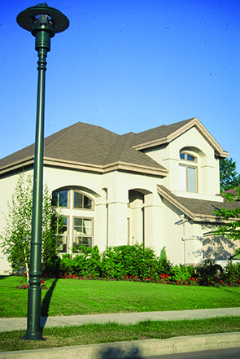
Round Aluminum Shapes
Notes:
Part of standard catalog
Only 4 options but we do lots of custom profiles
Spec lock opportunity
We can do this bc we own the extrusion facility and can taper at our own facility in a variety of sizes

Slide 19
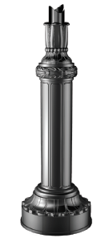
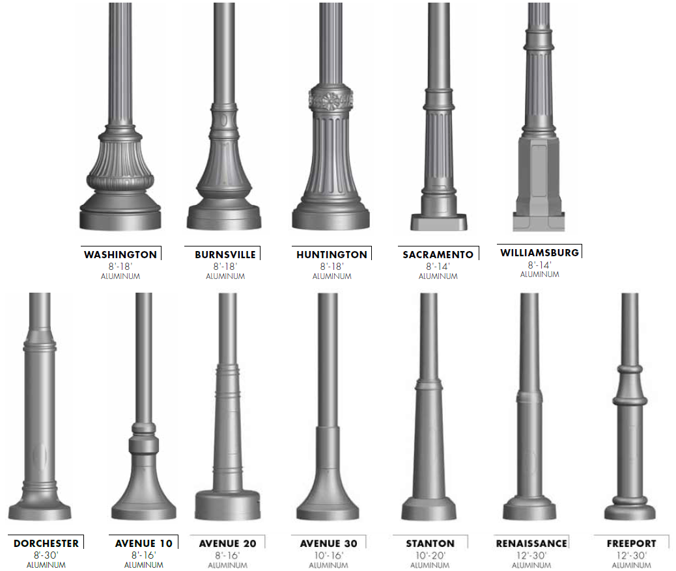
Historic and Contemporary Posts
Valmont provides a large variety of pole shapes and sizes
Can match fixture colors
1 piece designs
Earn commission and overage
Quick Ship program coming soon
BROOKHAVEN
8’ – 18’
ALUMINUM
Notes:
Our posts are one piece designs available in straight, tapered, fluted, or smooth. The four highlighted are some of our most popular and will soon be part of a quick ship program.

Slide 20
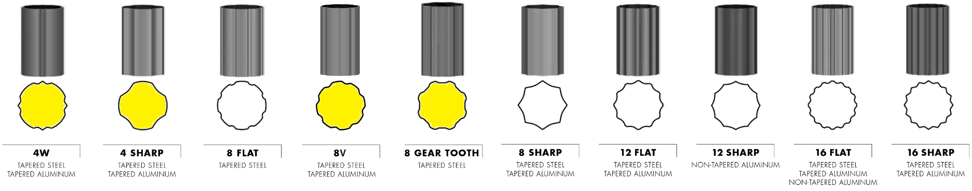
Flute Options
Valmont offers the most flute options in the industry
Clean, crisp, and uniform flute transitions
  Flute entire pole with one smooth motion
Ability to start and stop anywhere along the pole shaft
Notes:
Valmont offers the most flute options in the industry, and the flutes highlighted in yellow are proprietary to Valmont. Valmont is able to provide a clean crisp flute since the entire pole is fluted in one smooth motion. We are also able to start and stop the flute anywhere along the pole shaft.
Valmont offers most options in industry
4 in yellow are proprietary to Valmont – spec lock

Slide 21
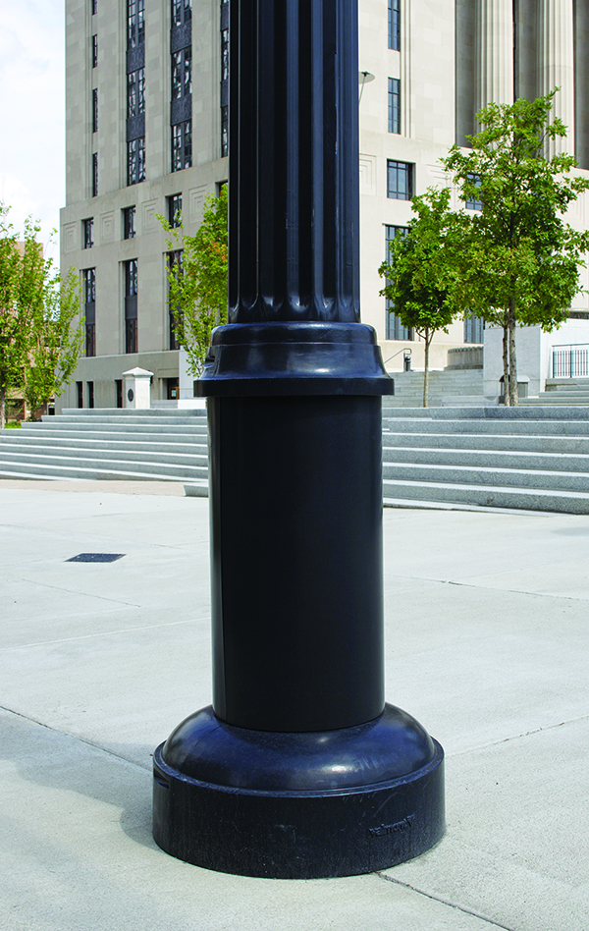
Flute Options
Accommodate Top and Side Mounting Fixtures and Arms
Start and Stop Flutes
Accommodate Decorative Bases

Slide 22
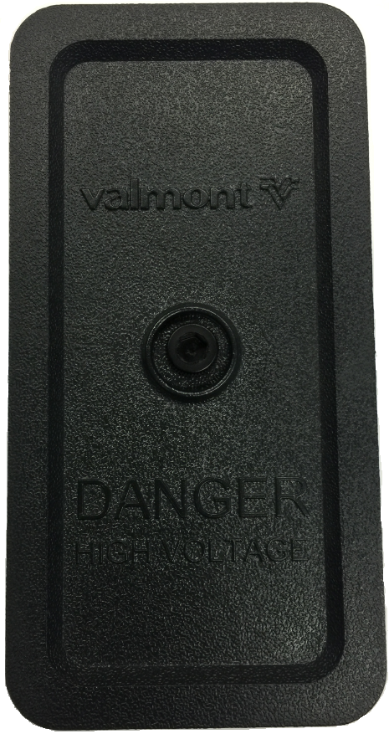
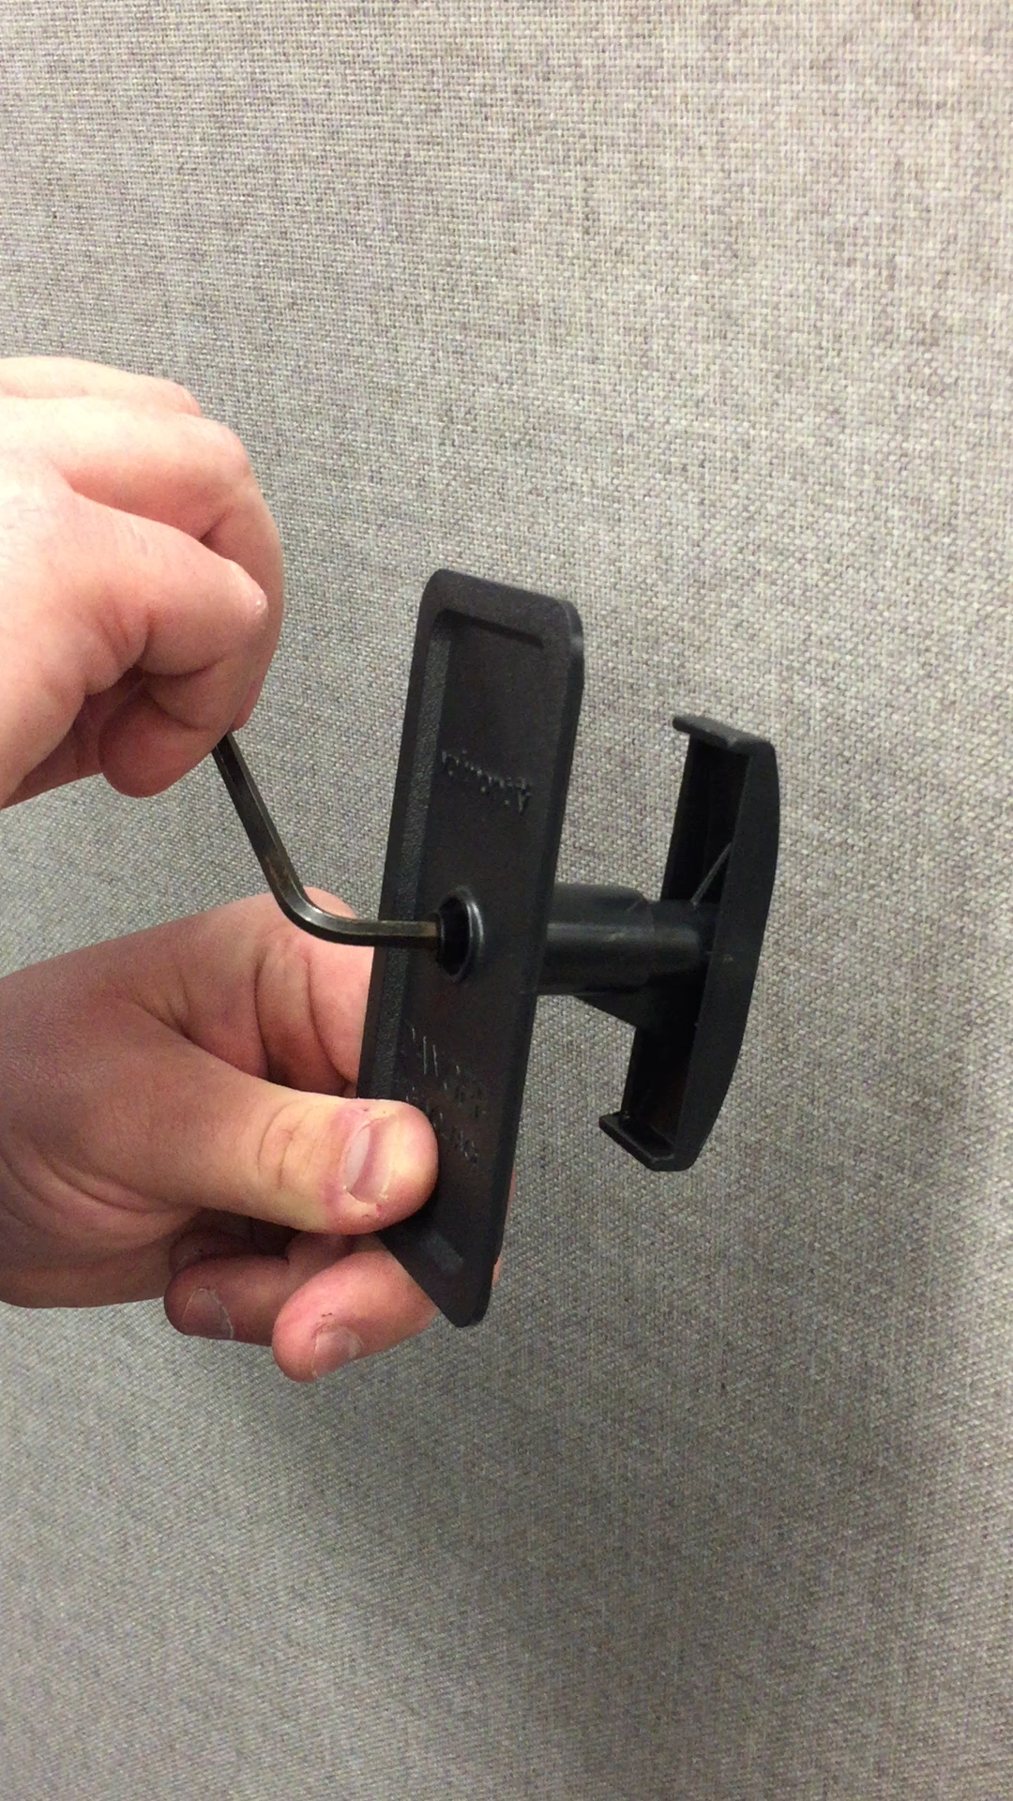
Swing Latch Hand Hole Cover
2.5” X 5” patented plastic swing latch hand hole cover
Perfect for DS330 and DS340
Benefits:
  Non-Corrosive
  Non-Conductive
  No Scrap Value
  No Hardware

Slide 23
UL Listed (Underwriters Laboratories)
All handholes shall be provided with a cover and a NEC Gasket Kit
Festoons
UL “Listed” applies to structures less than or equal to 12 feet in height
UL “Classified” applies to structures greater than 12 feet but less than 100 feet in height

Slide 24
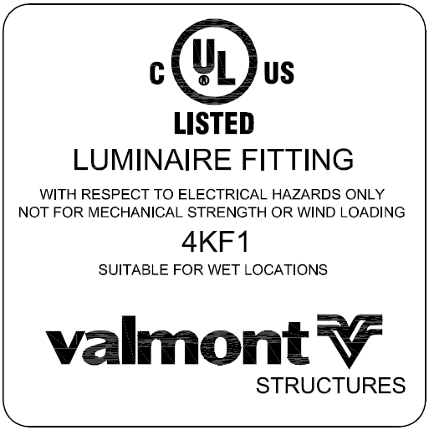
UL Listed (Underwriters Laboratories)
UL requires the sticker to be attached within 6” of the lowest handhole
Valmont has chosen to locate the sticker above the rim
Notes:
The UL sticker will be located above the handhole rim – on the outside of the pole.

Slide 25

Bid and Performance Bonds
Bid Bond: A bid bond is a guarantee provided to the project owner that states the bidder has the means to complete the job as stated in the bid documents. This is a written guarantee from a third party guarantor submitted to a client or customer by the bidder with the bid (quote). The amount of a bid bond is a certain percentage (e.g. 5%, 10%) of the price of the contract. This exists to reassure the company awarding the job that the bidder has the cash flow needed for the project.

Slide 26

Bid and Performance Bonds
Performance Bond (aka Supply Bond): A bond issued to one party as a guarantee against the failure of the other party to meet obligations specified in the contract. This is a written guarantee from a third party guarantor submitted to a client or customer by a contractor upon winning the bid. This bond usually covers 100% (percent) of the contract price and may replace the bid bond on award of the contract. A performance bond secures the promise to perform the contract in accordance with its terms and conditions, at the agreed upon price, and within the time allowed.

Slide 27
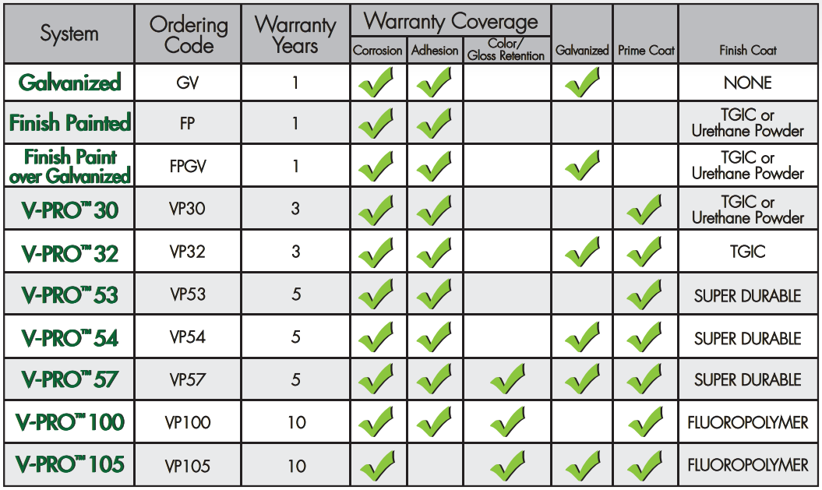
Coatings with Extended Warranties

Slide 28

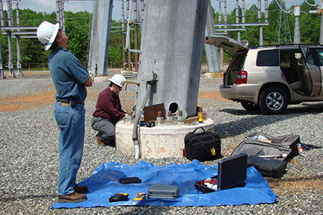
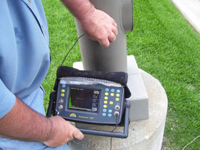
Partner with Matco Services
Routine light pole and tower safety inspections are essential to ensure the structural integrity of aging infrastructure
Clear recommendations for repairs, reinforcements, or replacement of at-risk structures

Slide 29
THANK YOU!
valmontstructures.com

